Slide 1
أكـــــاديميــــة طــــويـــق
Artificial Intelligence Ethics

Slide 2
Future Trends and Opportunities in AI Governance Navigating Ethics, Regulation, and Innovation
By: Dr. Afshan Hashmi

Slide 3
Course Objectives:
Define AI governance and explain its necessity
Identify and describe the foundational pillars of AI governance
Compare current global AI governance models and regulatory strategies
Analyze governance challenges and ethical implications in autonomous AI systems
Assess the impact of AI regulation on innovation and societal well-being
Examine real-world case studies to understand governance failures and successes

Slide 4

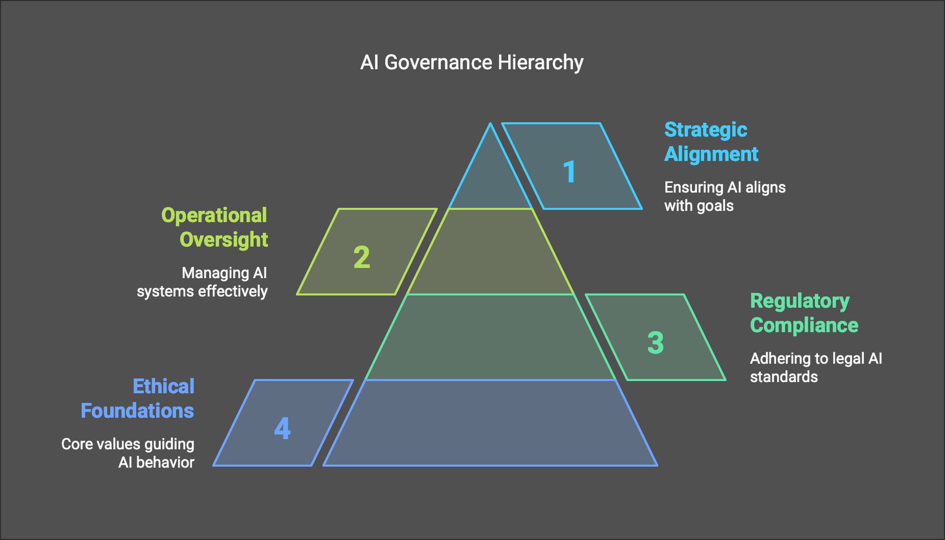
Introduction to AI Governance
What is AI Governance?
AI governance refers to the creation and implementation of policies, laws, frameworks, and best practices that guide the responsible development, deployment, and use of artificial intelligence systems. It aims to ensure that AI technologies are aligned with human rights, ethical norms, and societal values, preventing misuse while enabling innovation.

Slide 5
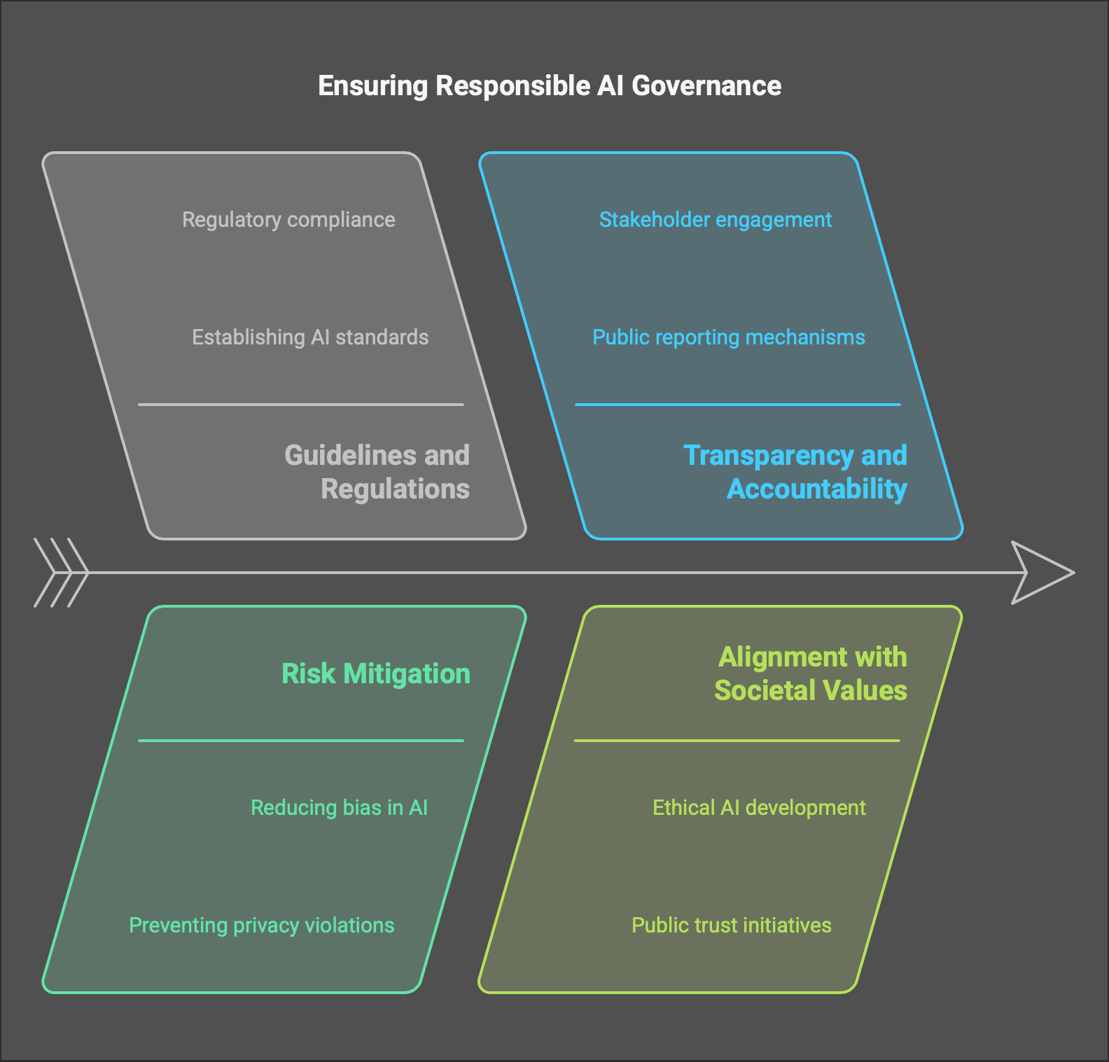
Why AI Governance Matters
AI systems increasingly influence decisions in vital sectors such as healthcare, criminal justice, finance, and education. Without proper governance, these systems can reinforce biases, create unfair outcomes, and cause harm. Governance provides oversight, builds public trust, and ensures AI systems operate transparently and ethically.

Slide 6
Pillars of AI Governance
Transparency & Explainability: AI models should provide clear, understandable reasoning for their decisions to ensure accountability and foster user trust.
Fairness & Non-discrimination: Systems should avoid perpetuating societal biases and ensure equal treatment across demographics.
Accountability & Responsibility: Clear attribution of responsibility is crucial when AI causes harm, whether it's the developer, deployer, or data provider.
Privacy & Data Protection: AI systems must comply with data protection laws and respect user privacy through anonymization and informed consent.
Safety & Robustness: AI should function reliably in diverse conditions and be resilient to errors, cyber-attacks, and unexpected inputs.

Slide 7
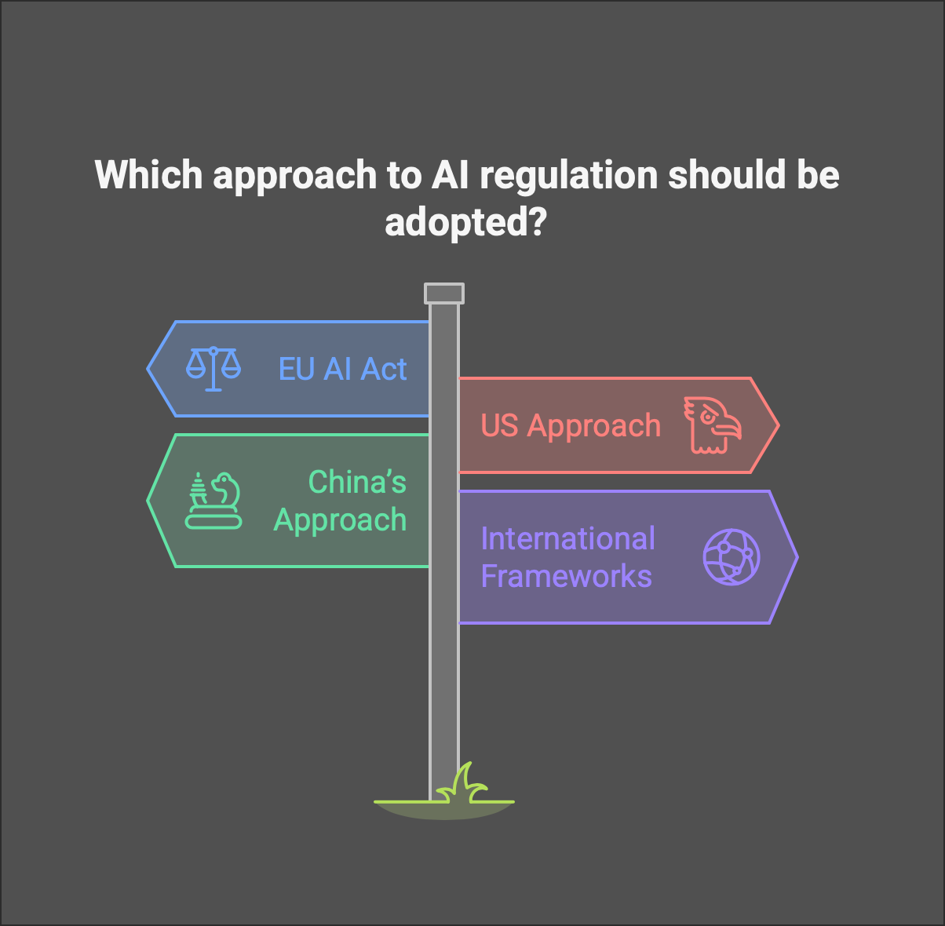
Current Governance Models
Governance models vary globally:
EU AI Act emphasizes a risk-based approach with strict obligations for high-risk systems.
US approach leans toward voluntary guidelines promoting innovation and self-regulation.
China focuses on strong state control and alignment of AI with national goals.
International frameworks like the OECD AI Principles and UNESCO guidelines aim to provide globally accepted standards.

Slide 8
AI Governance in Autonomous Systems
Autonomous systems such as drones, self-driving vehicles, and robotic surgeons challenge conventional governance models. These systems make decisions in real time, often without human intervention. Governance must ensure their decisions are safe, ethical, and legally compliant, even in unpredictable situations.
Challenges with Autonomous Systems:
Decision-making accountability: Determining liability is complex when a machine makes the final decision.
Testing and certification: It’s difficult to simulate every real-world scenario; regulatory bodies struggle to define standards.
Dynamic environments: Systems must adapt to evolving contexts while maintaining safety and compliance with regulations.

Slide 9

Real-world Example: Tesla Autopilot Tesla’s Autopilot has been involved in several controversial incidents. Investigations revealed overreliance by users, limitations in the technology, and unclear safety communication. This case illustrates the risks of deploying partially autonomous systems without clear governance.

Slide 10
Real-world Example: Tesla Autopilot Tesla’s Autopilot Controversies: This refers to real-world incidents where Tesla vehicles operating under the Autopilot mode were involved in crashes or near-misses. These events raised public and regulatory concern because they highlighted gaps between what the system can actually do and how users perceive it. User Overreliance: Many drivers treated Autopilot as a fully autonomous system, taking their attention away from the road. However, Tesla’s system is a Level 2 automation (driver-assist), which still requires full driver attention. This mismatch between perception and reality contributed to unsafe situations. Technological Limitations: Despite being advanced, the system has flaws—such as misinterpreting objects, failing to recognize lane changes, or struggling in complex driving environments. These limitations are not always clearly communicated to users.

Slide 11
Real-world Example: Tesla Autopilot Unclear Safety Communication: Tesla's marketing, terminology (like "Autopilot" or "Full Self-Driving"), and lack of consistent safety reminders have been criticized for misleading users about the actual capabilities and limits of the system. Governance Implications: This example shows that deploying AI-based systems, especially those affecting public safety, without strict rules, transparent communication, and regulatory oversight can lead to harm. It underscores the importance of comprehensive AI governance in autonomous technologies.

Slide 12
The Future of AI Regulation
As artificial intelligence continues to evolve at a rapid pace, traditional regulatory approaches often struggle to keep up that future AI regulation must be agile, adaptive, and supportive of innovation, while also protecting individuals and society.
Adaptive and Flexible Regulation
AI technologies change and improve quickly, so regulations can't be static. Future frameworks need to adapt in real time to new developments, such as generative AI, synthetic media, and autonomous decision-making.
This requires continuous learning by regulatory bodies and frequent updates to laws based on feedback from researchers, developers, and users.
Regulatory Sandboxes
These are controlled environments where AI companies can test new technologies under the supervision of regulators.
Sandboxes allow experimentation with less risk while ensuring basic safety and ethical guidelines are followed. For example, the UK and Singapore have already launched AI sandboxes to support innovation in healthcare and finance.

Slide 13
The Future of AI Regulation
4. Risk-Based Approaches
Not all AI systems need the same level of oversight. A risk-based framework evaluates systems based on their potential to cause harm.
For instance, a chatbot used for entertainment is low-risk, while an AI system making medical diagnoses is high-risk and requires more scrutiny.
This approach prevents overregulation, which can stifle innovation, while ensuring safety for high-impact use cases.
5. Balancing Innovation and Safety
The future of regulation must find a middle path: enabling startups and tech companies to develop new AI solutions, while ensuring those solutions are safe, fair, and respect human rights.
This balance can be achieved through mechanisms like pre-deployment impact assessments, post-market monitoring, and collaborative development of AI standards between government, industry, and academia.

Slide 14
International Cooperation in AI Governance
Artificial intelligence does not recognize national borders—its development, deployment, and impact are global in nature. For instance, an AI system trained in one country can easily be deployed across the world via cloud platforms or integrated into multinational products and services. This necessitates international cooperation to ensure AI is governed effectively and ethically across jurisdictions.
Global data flows, digital trade, and cybersecurity risks make it essential for countries to establish harmonized rules and interoperable standards. Without alignment, inconsistent regulations may lead to confusion, compliance burdens, or loopholes that allow unethical practices to flourish.

Slide 15
International Cooperation in AI Governance contd..
Organizations like the United Nations (UN), Organisation for Economic Co-operation and Development (OECD), and G7 are spearheading efforts to create shared frameworks. For example, the OECD’s AI Principles advocate for inclusive growth, transparency, and human-centered values. These efforts aim to foster trust, accountability, and innovation globally.
However, challenges remain. Different countries have divergent priorities, some emphasize national security, others economic competitiveness, and some focus on protecting civil liberties. Reconciling these differences while ensuring effective oversight and innovation is one of the biggest hurdles in building a truly global AI governance framework.

Slide 16

Evolving Standards and Guidelines
Governments and industries are creating dynamic, interoperable standards to regulate AI effectively. Examples include ISO standards for AI, NIST’s risk management framework, and regulatory sandboxes. These help stakeholders test AI systems safely while fostering innovation.

Slide 17
Evolving Standards and Guidelines contd..
Dynamic and interoperable standards mean the rules are not only evolving as technology changes (dynamic) but also designed to work across different industries and countries (interoperable), reducing fragmentation in global AI governance.
ISO standards: The International Organization for Standardization (ISO) is developing international AI standards for areas like safety, transparency, and risk management. These standards help companies design AI systems that meet global expectations and build trust with users.

Slide 18
Evolving Standards and Guidelines contd..
NIST’s Risk Management Framework: The U.S. National Institute of Standards and Technology (NIST) created a framework that guides organizations in identifying, evaluating, and mitigating risks associated with AI, such as bias, lack of explainability, or misuse.
Regulatory sandboxes: These are safe, controlled environments where companies and regulators collaborate to test new AI systems under regulatory supervision. This allows innovation without the fear of immediate legal penalties, and helps governments understand how to update or create appropriate laws.
In short, these tools and frameworks help balance innovation and safety letting AI grow responsibly without being recklessly unregulated or overly restricted

Slide 19
Ethical Frameworks and Global Ethics
Ethical norms vary across cultures, complicating global governance. Different societies have different values-what's considered ethical in one country might not be in another.
For example, Western nations like those in the EU often prioritize privacy and individual rights, while other regions may emphasize collective benefits or economic development. This diversity makes it hard to create a single global ethical framework for AI.
While the EU prioritizes privacy, other regions focus more on economic growth.
This highlights the trade-off in governance priorities. The EU’s General Data Protection Regulation (GDPR) strictly regulates data usage to protect individuals, whereas countries like China or some in Southeast Asia may adopt a more permissive stance to foster rapid AI innovation and economic competitiveness.

Slide 20
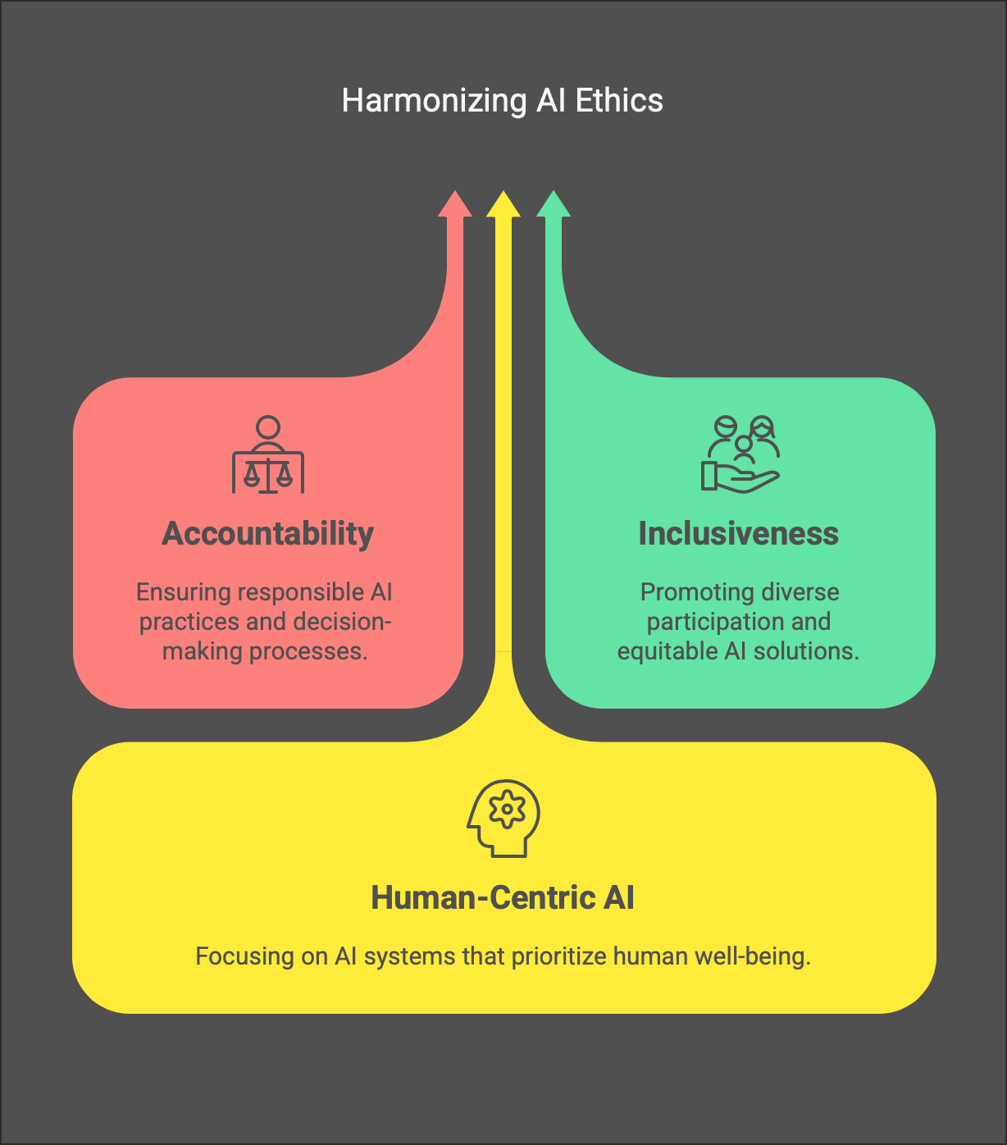
Ethical Frameworks and Global Ethics contd..
UNESCO and IEEE are working toward unified ethical principles like accountability, inclusiveness, and human-centric AI.
Despite these differences, international bodies like UNESCO (a UN agency) and the IEEE (a global engineering organization) are trying to build common ground by promoting universal values.
Their efforts include publishing frameworks that advocate for AI systems that are transparent, inclusive of all populations, and prioritize human well-being over efficiency or profit.

Slide 21
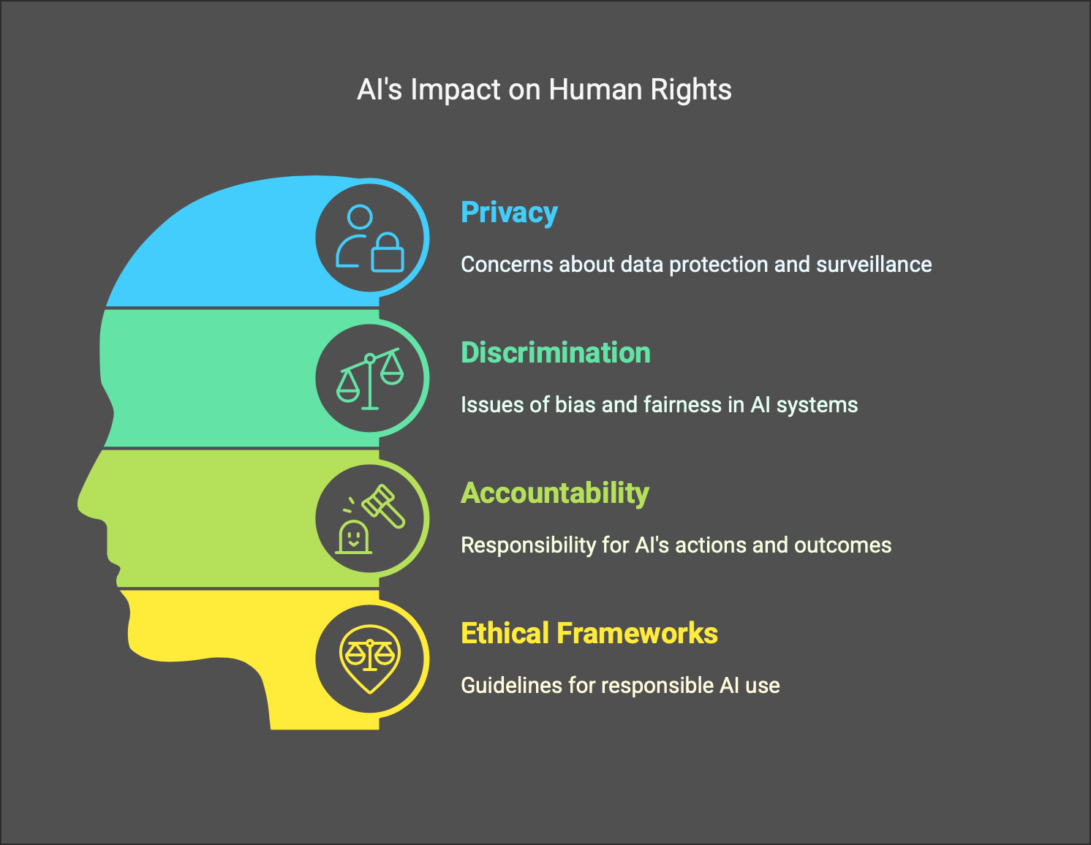
AI and Human Rights
AI technologies increasingly influence our fundamental human rights, raising concerns about how these rights are preserved or violated during AI development and deployment.
For instance, facial recognition tools and predictive policing algorithms can infringe on privacy and freedom of movement.
Additionally, biased training data may result in discrimination against certain groups in areas like hiring, lending, and law enforcement.

Slide 22
AI and Human Rights contd..
Systems used for mass surveillance - like those implemented in authoritarian regimes, may stifle freedom of expression and assembly, chilling political participation. Moreover, AI decisions are often made without human transparency, leaving individuals unable to challenge decisions that affect their lives.
Therefore, AI governance must explicitly align with international human rights frameworks, such as the Universal Declaration of Human Rights and the International Covenant on Civil and Political Rights. Embedding these values ensures technologies serve people equitably and preserve dignity, freedom, and justice in an AI-powered future.

Slide 23
Governance’s Dual Impact on Innovation
Good AI governance fosters innovation by building trust, ensuring transparency, and setting clear expectations for developers and companies.
When rules are well-defined and stable, investors and stakeholders feel more confident putting money and effort into AI projects, knowing there’s a predictable environment. It also encourages developers to create ethically aligned technologies that meet social and legal expectations, which can expand market acceptance and adoption.
However, overly strict or ambiguous regulations can have the opposite effect. If rules are too rigid, unclear, or burdensome, organizations may be discouraged from experimenting or launching new AI technologies due to high compliance costs or fear of legal consequences. This can stifle creativity, delay product releases, and ultimately hinder technological progress, especially in fast-moving sectors.

Slide 24
Governance and Societal Well-being
Artificial Intelligence (AI) holds the power to revolutionize critical sectors in society.
For instance, in personalized healthcare, AI can analyze patient data to offer tailored treatment plans, predict disease outbreaks, or assist in early diagnosis.
In environmental monitoring, AI can track pollution levels, detect deforestation through satellite imagery, or optimize energy consumption.
It also aids in disaster prediction, by processing weather patterns and geological data to anticipate events like floods or earthquakes, enabling quicker responses and potentially saving lives.

Slide 25
Governance and Societal Well-being & Challenges
AI also brings serious challenges.
Job displacement is a growing concern as automation replaces human labour in industries like manufacturing, customer service, and logistics.
Moreover, the rapid deployment of AI technologies can deepen digital inequality, where those with access to AI tools thrive, while underserved populations fall further behind.
To address this duality, AI governance policies must be designed to promote fairness and accessibility. This includes expanding access to AI education, supporting underserved communities, and ensuring AI systems are designed with inclusivity in mind.
The overarching goal is to guide AI development in a way that delivers positive, widespread societal benefits, rather than exacerbating existing disparities.

Slide 26
Case Study 1: EU AI Act
The EU AI Act is a landmark legal proposal classifying AI systems by risk level. High-risk systems must meet stringent transparency, accuracy, and human oversight requirements. This approach balances safety and innovation, serving as a model for other nations.
The EU AI Act introduces a risk-based classification system for AI technologies. This means AI systems are evaluated and categorized based on the potential harm they could cause to people’s safety or fundamental rights. For example, applications in healthcare or law enforcement might be considered high-risk, while entertainment-related AI might fall into a lower-risk category.

Slide 27
Case Study 1: EU AI Act contd..
For high-risk systems, the Act imposes strict requirements to ensure trust and accountability. These include:
Transparency: Users must be informed when they are interacting with an AI system.
Accuracy: The system must be thoroughly tested to perform reliably.
Human oversight: There must be provisions to allow humans to monitor and intervene if necessary.
This approach is designed to balance innovation with public safety, allowing Europe to benefit from AI advancements while minimizing potential harm. Because of its structured and comprehensive nature, the EU AI Act is often viewed as a model for other countries exploring how to govern AI effectively.

Slide 28

Case Study 2: Clearview AI
Clearview AI collected billions of online photos to power its facial recognition. Privacy watchdogs raised concerns over consent and legality. Several countries banned the app. This case sparked international debates on biometric data governance and ethical boundaries.
It is a U.S.-based facial recognition company that created a massive database by scraping over 3 billion images from public websites like Facebook, LinkedIn, and Instagram without obtaining user consent. This action raised serious concerns among privacy advocates and regulatory authorities, as it violated data protection and privacy norms in several jurisdictions.

Slide 29
Case Study 2: Clearview AI contd..
Governments and watchdog agencies in countries like Canada, Australia, and across the EU challenged the legality of Clearview’s data collection, resulting in fines, regulatory orders, and in some cases, outright bans of the application.
These controversies sparked global debates about the ethical boundaries of using biometric data, especially in law enforcement.
The Clearview case has become a landmark example highlighting the urgent need for stricter AI governance, especially for facial recognition and surveillance technologies.
It underscores how unchecked AI deployment can lead to mass surveillance, loss of individual privacy, and erosion of civil liberties.

Slide 30
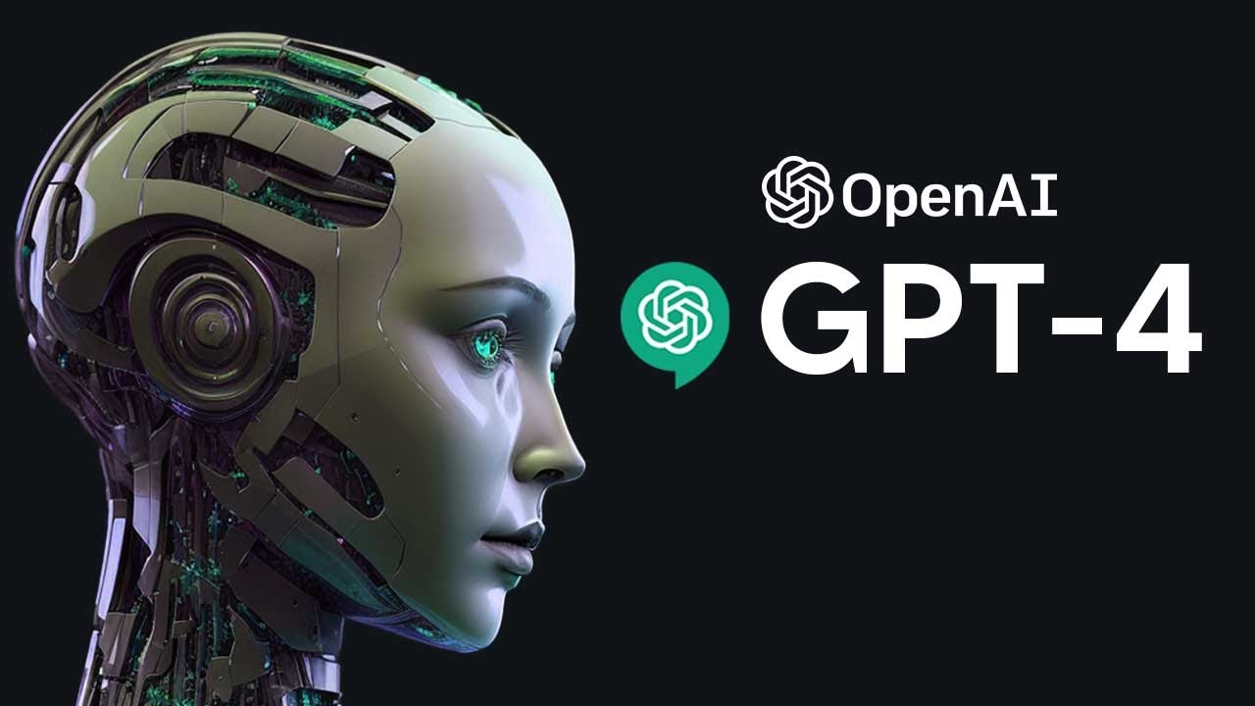
Case Study 3: OpenAI GPT-4
Large language models like GPT-4 raise concerns over misinformation, copyright infringement, and biased outputs. OpenAI adopted a gradual deployment strategy, incorporating safety research and user feedback. This case illustrates governance in powerful generative AI systems.
Large language models (LLMs) like GPT-4 have the potential to revolutionize various industries, but they also introduce several significant challenges.
Misinformation: LLMs can generate text that appears credible but may contain inaccuracies, misleading information, or outright falsehoods. Since these models are trained on vast amounts of internet data, they may inadvertently propagate harmful content or unverified facts, potentially exacerbating issues related to fake news and disinformation.
Copyright Infringement: LLMs like GPT-4 can generate text based on patterns and data derived from existing works, raising concerns over whether these models are inadvertently replicating or infringing upon copyrighted content. This creates legal and ethical dilemmas regarding ownership and intellectual property rights.

Slide 31
Case Study 3: OpenAI GPT-4
3. Biased Outputs: Despite efforts to reduce bias in training data, LLMs still carry the risk of generating biased, discriminatory, or harmful content. This is because they are trained on historical and societal data, which often contains inherent biases. These models may reinforce stereotypes or produce outputs that disproportionately harm certain groups.
OpenAI's Approach: To mitigate these risks, OpenAI adopted a gradual deployment strategy. This means that rather than releasing GPT-4 to the public all at once, the company rolled it out progressively, allowing for ongoing testing, feedback, and safety research. This approach helps ensure that any issues with the model can be addressed before full-scale deployment, incorporating user feedback and conducting additional safety checks.
This case highlights the importance of governance in powerful AI systems like GPT-4. Proper governance frameworks are crucial for overseeing the ethical use of AI, ensuring it operates responsibly, and balancing its vast potential with the need for accountability and fairness.

Slide 32
AI Governance: Industry Perspectives
Industry players often push for self-regulation but also invest in internal ethics teams. While some companies actively contribute to policy, others resist external oversight. The balance between corporate autonomy and regulatory enforcement remains a central debate.
The industry's viewpoint is shaped by several factors:
Self-regulation: Many companies in the AI industry advocate for self-regulation rather than strict government-imposed rules. They argue that businesses are better equipped to understand the nuances of AI technologies and that industry-driven guidelines allow for more flexibility and quicker adaptation to technological advancements. This can also foster innovation by reducing bureaucratic delays associated with regulatory bodies.
Internal Ethics Committees: Larger companies often establish internal ethics teams that work to ensure AI systems are being developed and deployed in a manner consistent with ethical principles. These teams are responsible for reviewing AI models, identifying potential risks, and recommending safeguards to prevent harm, bias, or misuse.

Slide 33
AI Governance: Industry Perspectives contd..
3. Resistance to External Oversight: While some companies are proactive in promoting ethical AI, others might resist external oversight due to concerns about how regulation could impact profit margins or limit creative freedom. There’s often a fear that government-imposed regulations could slow down innovation, increase compliance costs, or limit the scope of certain AI applications.
4. Balancing Innovation with Regulation: The debate between fostering innovation and ensuring public safety and trust remains central to AI governance. Striking the right balance is crucial for the industry. Without sufficient regulation, there’s a risk of harmful outcomes like algorithmic bias, discrimination, or privacy violations. Conversely, too much regulation could stifle innovation or lead to overly cautious approaches that hinder technological progress.
Ultimately, this slide highlights the complexity of AI governance from the industry’s perspective, where autonomy and innovation are important, but ethical considerations and public accountability cannot be overlooked. The role of governance should allow for innovation while ensuring ethical standards, transparency, and accountability are maintained.

Slide 34
The Role of Academia and Civil Society Academics explore algorithmic fairness and bias detection, while civil society groups advocate for rights and transparency. These actors shape public discourse and influence legislation by publishing research, filing lawsuits, and engaging in public awareness campaigns. Here’s a breakdown of their roles: Academia's Role: 1. Research & Knowledge Creation: Universities and research institutions play a pivotal role in advancing AI ethics, fairness, and transparency. Scholars conduct studies on algorithmic bias, fairness, and AI's social impact, providing evidence-based frameworks that help shape policy and governance models.

Slide 35
The Role of Academia and Civil Society 2. Innovation: Academics are at the forefront of developing new AI technologies. Their research often challenges the status quo, proposing new methods for building ethical AI, improving model interpretability, and addressing safety concerns. 3. Ethical Training: Academia also trains the next generation of AI professionals, embedding ethical thinking into their training. This ensures that future technologists, engineers, and policymakers understand the social and ethical implications of their work.

Slide 36
The Role of Academia and Civil Society Civil Society's Role: 1. Advocacy & Public Awareness: Civil society organizations, including NGOs, activists, and social movements, advocate for the rights and interests of the public in AI policy discussions. They push for regulations that protect privacy, equality, and human rights. 2. Monitoring and Accountability: Civil society organizations often act as watchdogs, holding corporations and governments accountable for how AI systems are deployed and ensuring these systems don’t exacerbate inequalities or violate rights. 3. Public Engagement: They engage with the general public, increasing awareness of AI’s potential risks and benefits. Through campaigns, debates, and consultations, civil society ensures that AI governance is inclusive and reflects the diverse needs of society. Together, academia and civil society provide a checks-and-balances system that helps shape AI governance. While academia pushes for ethical frameworks and rigorous research, civil society ensures that AI technologies are aligned with the public good and advocates for the voices of marginalized groups. Their contributions are crucial in creating a balanced, fair, and accountable AI ecosystem.

Slide 37
Challenges in AI Governance The major challenges that hinder the effective governance of AI systems. AI governance aims to regulate and control the development and deployment of AI technologies in a way that is ethical, fair, and transparent. However, several complex issues need to be addressed to ensure proper governance: Technical Opacity: Many AI models, particularly deep learning models, are often described as "black boxes." This means their decision-making process is not easily interpretable by humans. It is difficult to understand how these models arrive at their conclusions, which raises concerns about accountability and trust in their outputs. In governance, this opacity creates a problem because regulators and stakeholders may struggle to assess whether AI systems are working ethically, fairly, and in compliance with regulations. Transparent models or the development of techniques for explainable AI (XAI) are essential to overcoming this challenge. Regulatory Lag: AI technology evolves at a rapid pace, often faster than legislative bodies can enact new laws or regulations. This creates a situation where regulations may be outdated or ineffective in addressing current AI developments. For instance, by the time a regulatory body creates guidelines for an emerging technology, that technology may have already surpassed the initial regulatory framework. This lag makes it difficult to establish rules that can keep pace with innovation while maintaining control over the risks posed by AI.

Slide 38
Challenges in AI Governance Cross-border Enforcement: AI technologies and their impact are often global. AI systems can be deployed across multiple countries, but enforcing national laws on AI is difficult when the technology operates across borders. Different countries may have different laws and standards governing AI, and jurisdictional challenges make it hard to hold companies accountable or ensure that AI systems adhere to all applicable rules. This calls for international cooperation and standardized governance frameworks that can address these cross-border challenges and create cohesive, harmonized policies. In Summary: These three challenges-technical opacity, regulatory lag, and cross-border enforcement highlight the difficulties in establishing robust and comprehensive AI governance. Solving these issues requires innovative solutions such as the development of more transparent AI models, faster regulatory adaptation processes, and global collaboration in governance efforts.

Slide 39
Opportunities Ahead As AI technologies continue to evolve, new possibilities arise for strengthening governance frameworks. These opportunities focus on collaboration, innovation, and improving the global approach to AI regulation: Global AI Treaties to Harmonize Ethics and Risk Management: As AI technologies are not confined to any one country, international cooperation is essential. The idea behind global AI treaties is to create a unified legal framework across borders, ensuring that AI systems adhere to ethical principles and that risk management approaches are consistent worldwide. These treaties would aim to set common guidelines and standards for AI ethics, privacy, and safety, reducing the risks posed by differences in national regulations. Harmonizing these rules helps create a level playing field for countries and corporations, while promoting responsible AI development globally.

Slide 40
Opportunities Ahead contd.. Collaborative R&D among Governments, Academia, and Industry: Innovation in AI governance will likely flourish through collaborative research and development. Governments, universities, and private industry can pool their resources and expertise to advance AI regulation. By working together, they can share knowledge, develop new frameworks, and test regulations in real-world scenarios. Such collaboration can lead to the creation of more adaptable, forward-thinking governance models that take into account the latest AI advancements and challenges. This collaborative effort can also help ensure that AI is developed in a way that benefits all sectors of society.

Slide 41
Opportunities Ahead contd.. Careers in AI Policy: As AI governance continues to evolve, there will be an increasing demand for AI policy professionals. These experts will bridge the gap between the technical world of AI and the legal, ethical, and regulatory frameworks that are needed to manage its impact. AI policy professionals will have the opportunity to shape the future of AI by crafting policies that balance innovation with public safety, fairness, and human rights. This field offers an exciting career path for individuals interested in both technology and governance. In Summary: By pursuing these opportunities, stakeholders can create a more coherent, ethical, and effective AI governance framework that fosters

Slide 42
RECAP
Governance is essential for ethical, trustworthy AI.
Future trends include flexible regulation and international cooperation.
Society must balance innovation with public interest.
Reflection prompt: What would your ideal AI governance framework look like in your country?

Slide 43
Resources for Further Study
EU AI Act: europa.eu/ai-act
OECD Principles: oecd.ai
UNESCO AI Ethics: unesco.org
Books: "The Alignment Problem" by Brian Christian, "Atlas of AI" by Kate Crawford
Journals: AI & Society, Journal of AI Research

Slide 44











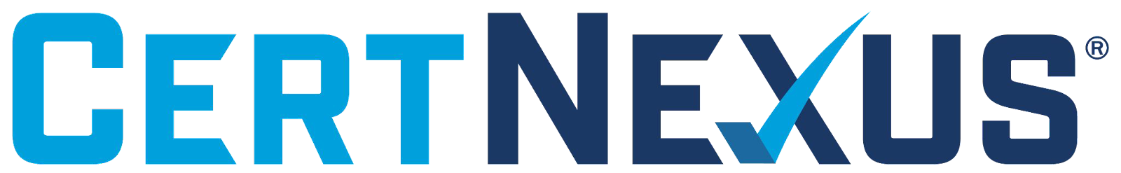





الشراكات العالمية

Slide 45
شــــــكــــرًا لكــــــم
THANK YOU

